Slide 1
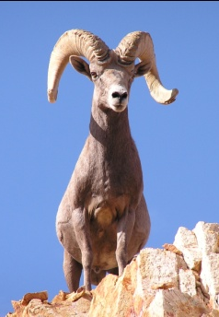
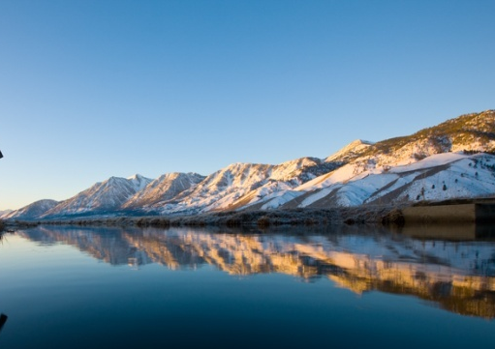
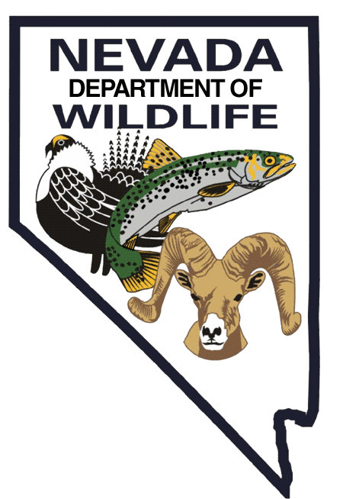
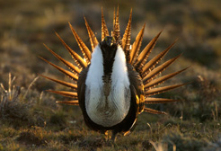
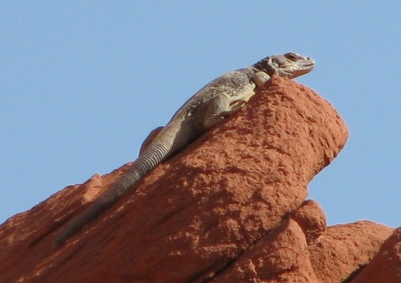
Department of Wildlife
2023 Capital Improvement Projects
Agency Request

Slide 2
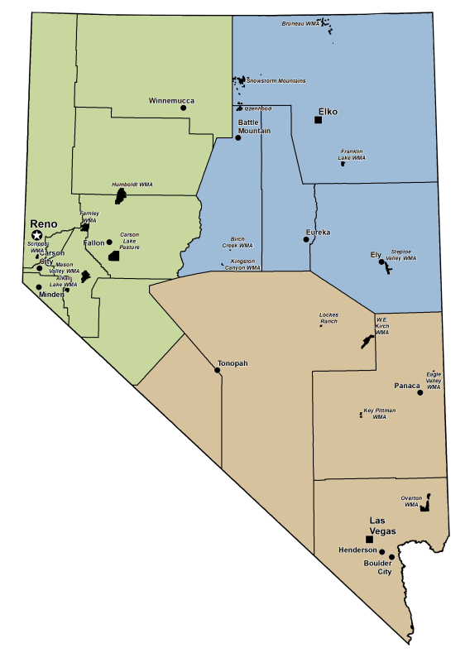
Department of Wildlife
DATS
262 Full-time Employees
133 Buildings
13 Radio Towers
11 Wildlife Management Areas (120,000 ac.)
8 Major Facilities
7 Unique Divisions
4 Fish Hatcheries
3 Regions

Slide 3
Department of Wildlife Prioritized Project Overview
Project #21248 – Gallagher Fish Hatchery – Hatchery Building Water Intrusion Repairs
Gallagher Fish Hatchery – Ruby Valley
Project #23138 – Key Pittman WMA Residential Water Intrusion Repairs
Key Pittman Wildlife Management Area - Hiko
Project #23139 – Eagle Valley Dam Maintenance Project
Spring Valley State Park – Spring Valley
Project #23140 – Kingston Canyon Dam Maintenance Project
Kingston Canyon - Kingston
Project #23141 – Illipah Dam Maintenance Project
Illipah

Slide 4
Department of Wildlife Prioritized Project Overview
Continued
Project #23143 – Bruneau River WMA Structure Demolition
Bruneau River Wildlife Management Area – Elko County
Project #23144 – Mason Valley WMA Lux Lane Bridge Maintenance
Mason Valley Wildlife Management Area - Yerington
Project #23145 – Mason Valley WMA Culvert Replacement
Mason Valley Wildlife Management Area – Yerington
Project #21052 – Steptoe Valley WMA Building Demolition
Steptoe Valley Wildlife Management Area – Ely
Project #7606 – Mason Valley WMA Office and Heavy Equipment Repair Shed
Mason Valley Wildlife Management Area - Yerington

Slide 5
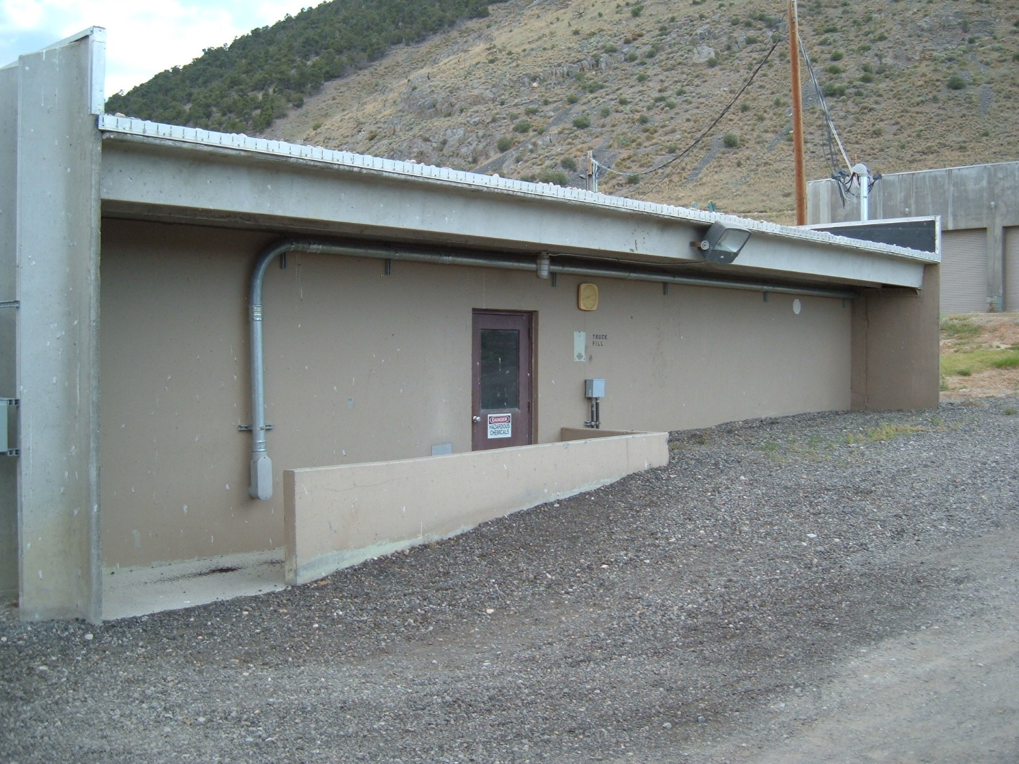
Gallagher Fish Hatchery
Hatchery Building Water Intrusion Repairs
Project #21248
Ruby Valley, Elko County, Nevada

Slide 6
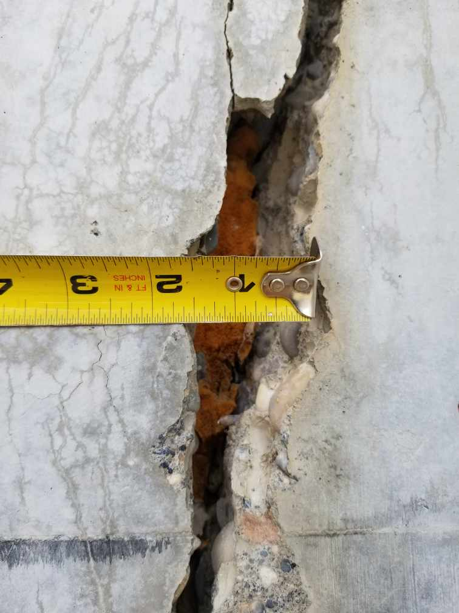
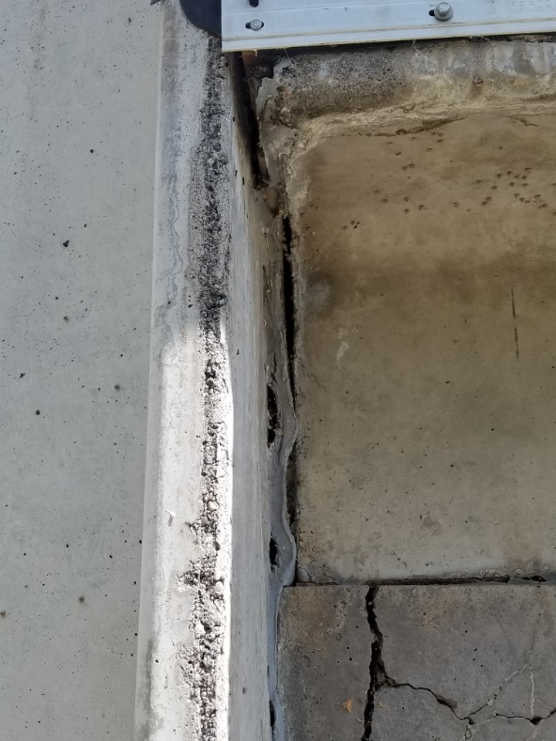
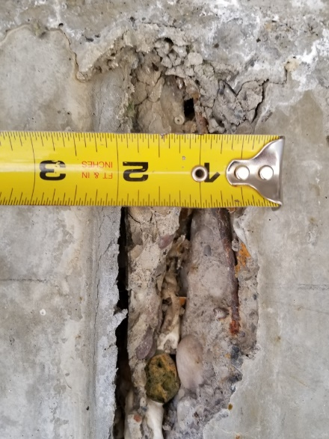
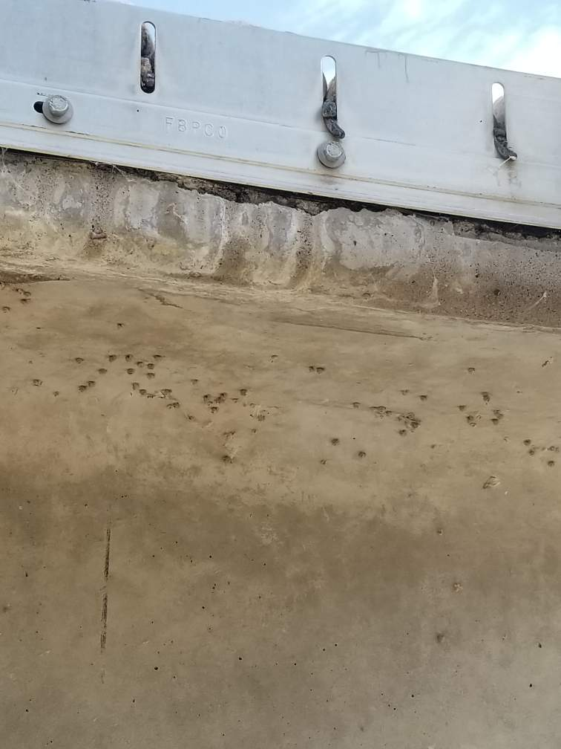
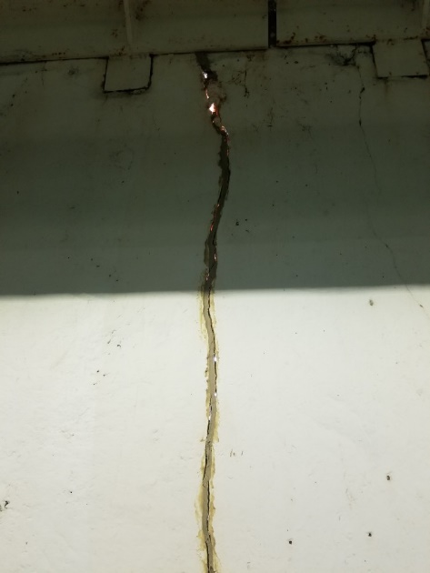
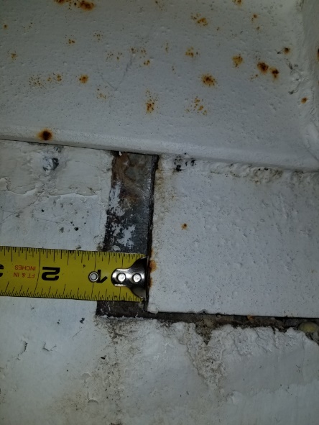
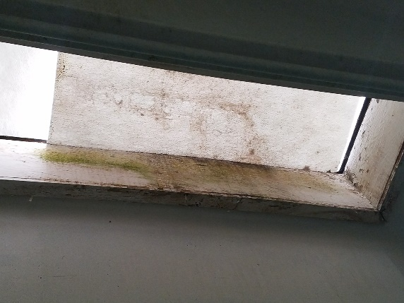
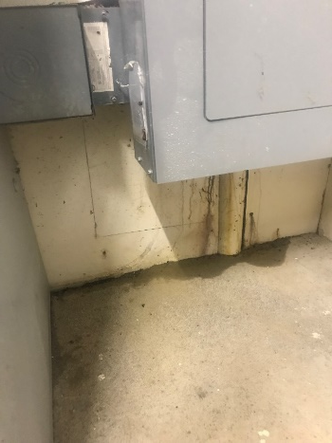
Hatchery Building Water Intrusion Repairs
Ruby Valley, Elko County, Nevada

Slide 7
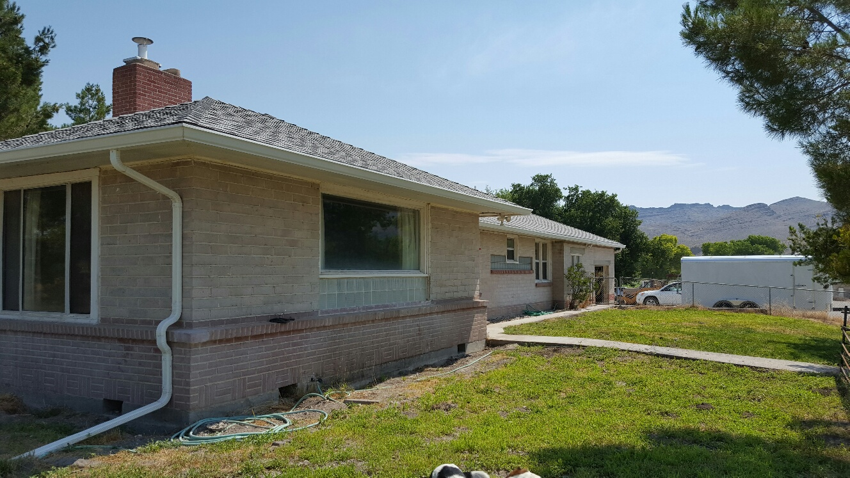
Key Pittman Wildlife Management Area
Residential Water Intrusion Repairs
Project #23138
Hiko, Lincoln County, Nevada

Slide 8
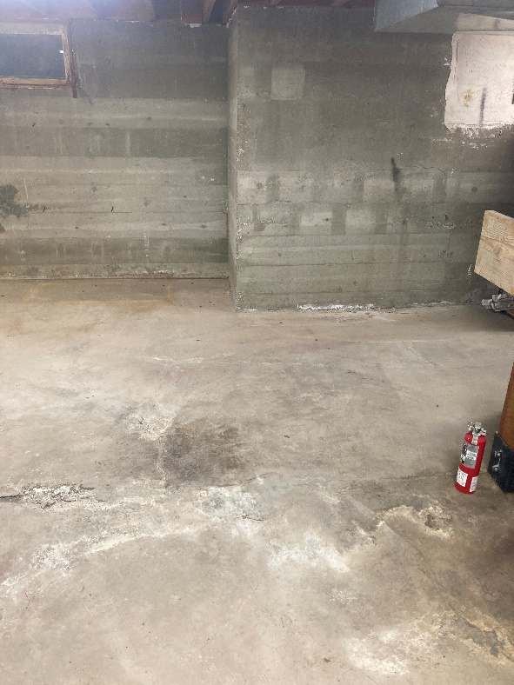
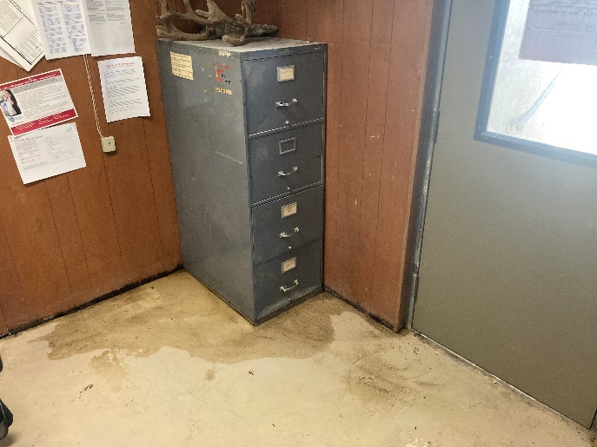
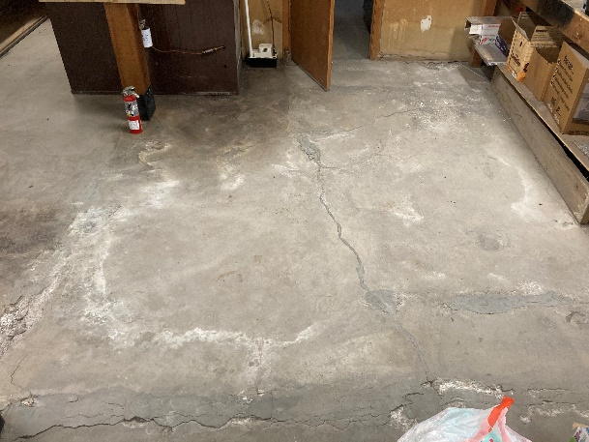
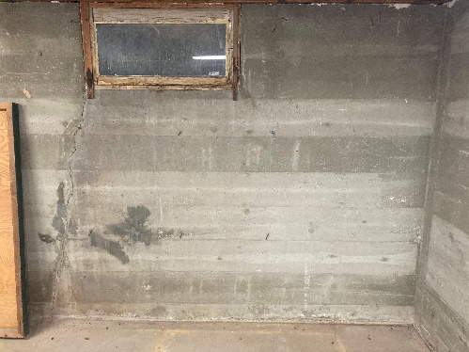
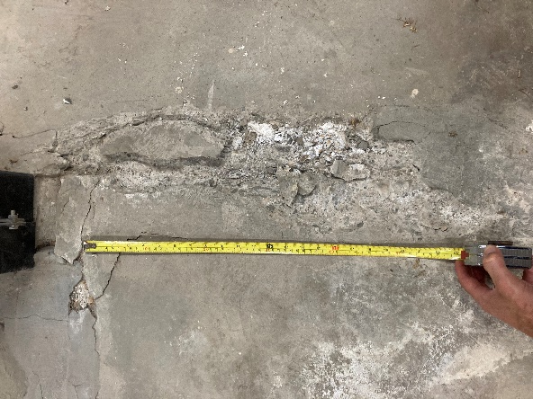
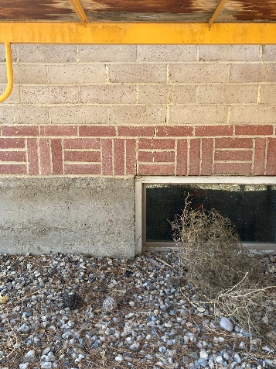
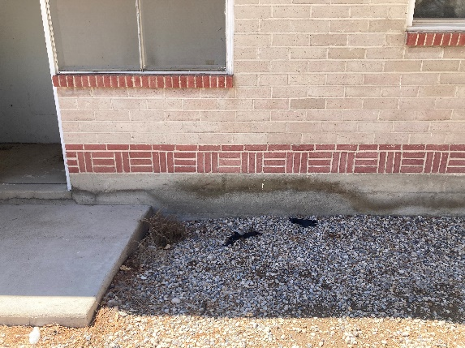
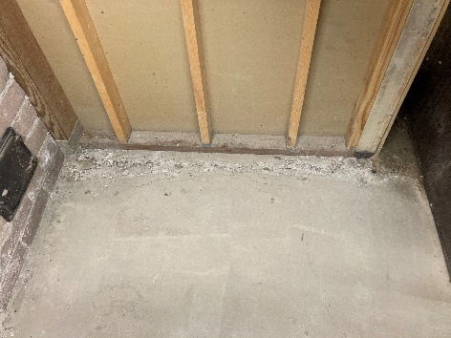
Residential Water Intrusion Repairs
Hiko, Lincoln County, Nevada

Slide 9
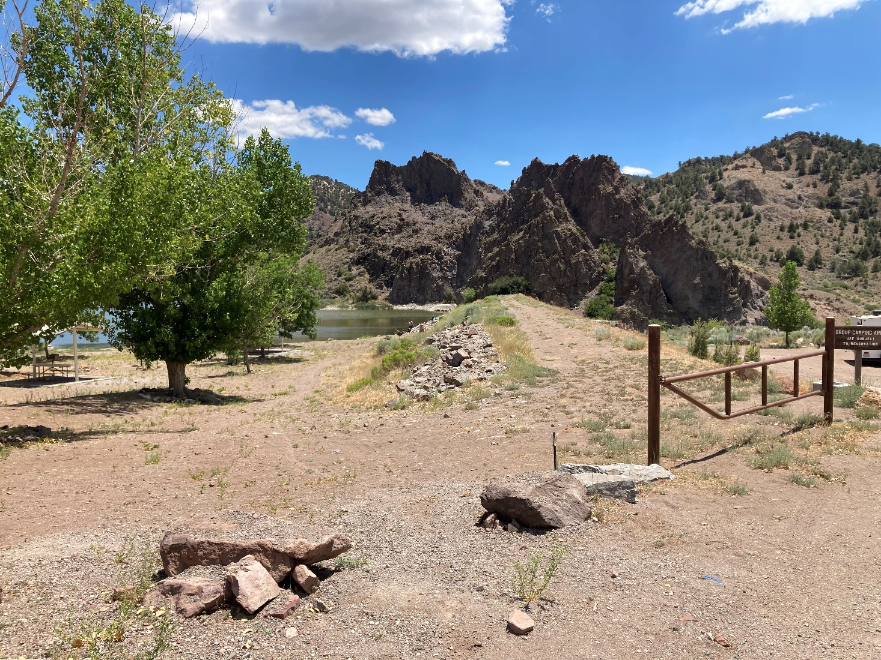
Eagle Valley Dam Maintenance Project Project # 23139 Ursine, Lincoln County, Nevada

Slide 10
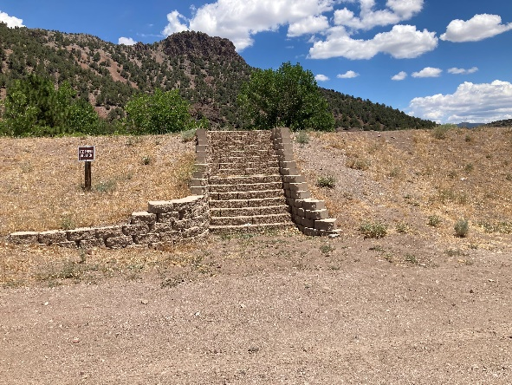
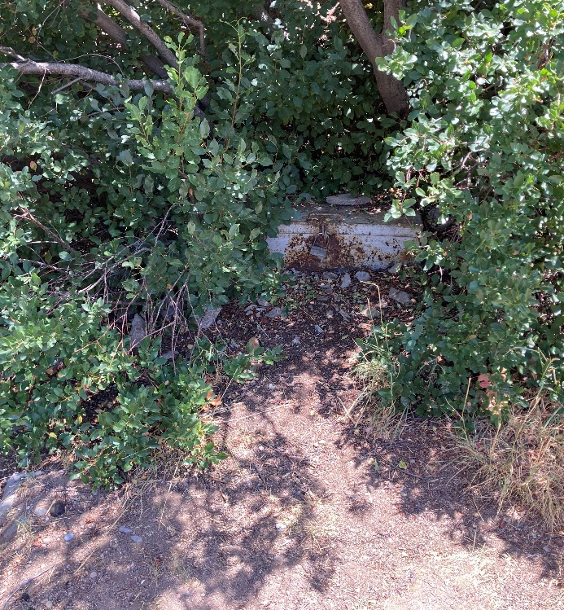
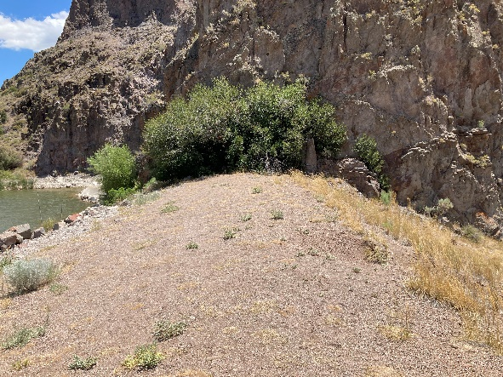
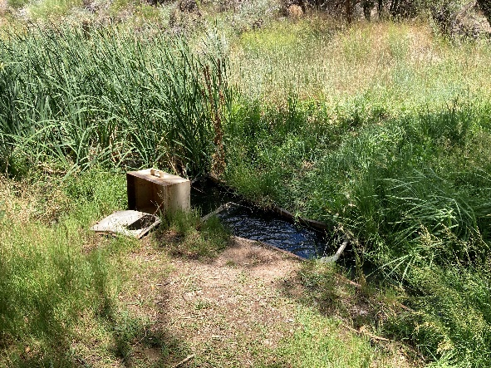
Eagle Valley Dam Ursine, Lincoln County, Nevada
Due to downstream development, dam is classified as a High hazard dam. Overall condition of dam is rated as Fair. Division of Water Resources has identified the following items that require corrective action:
Exercise outlet gate of principal spillway.
Seal concrete of auxiliary spillway.
Backfill and compact rodent holes and burrows.
Remove vegetation within 25’ of dam structure.
Prevent foot and vehicle traffic from damaging dam.
Install seepage collection system to monitor flow and turbidity.
Fill and compact erosion gullies.
Remove vegetation from Parshall Flume.
Restore shape of dam crest to consistent, uniform grade.
Remove stairs from dam face.
Restore dam slopes to consistent, uniform slope.

Slide 11
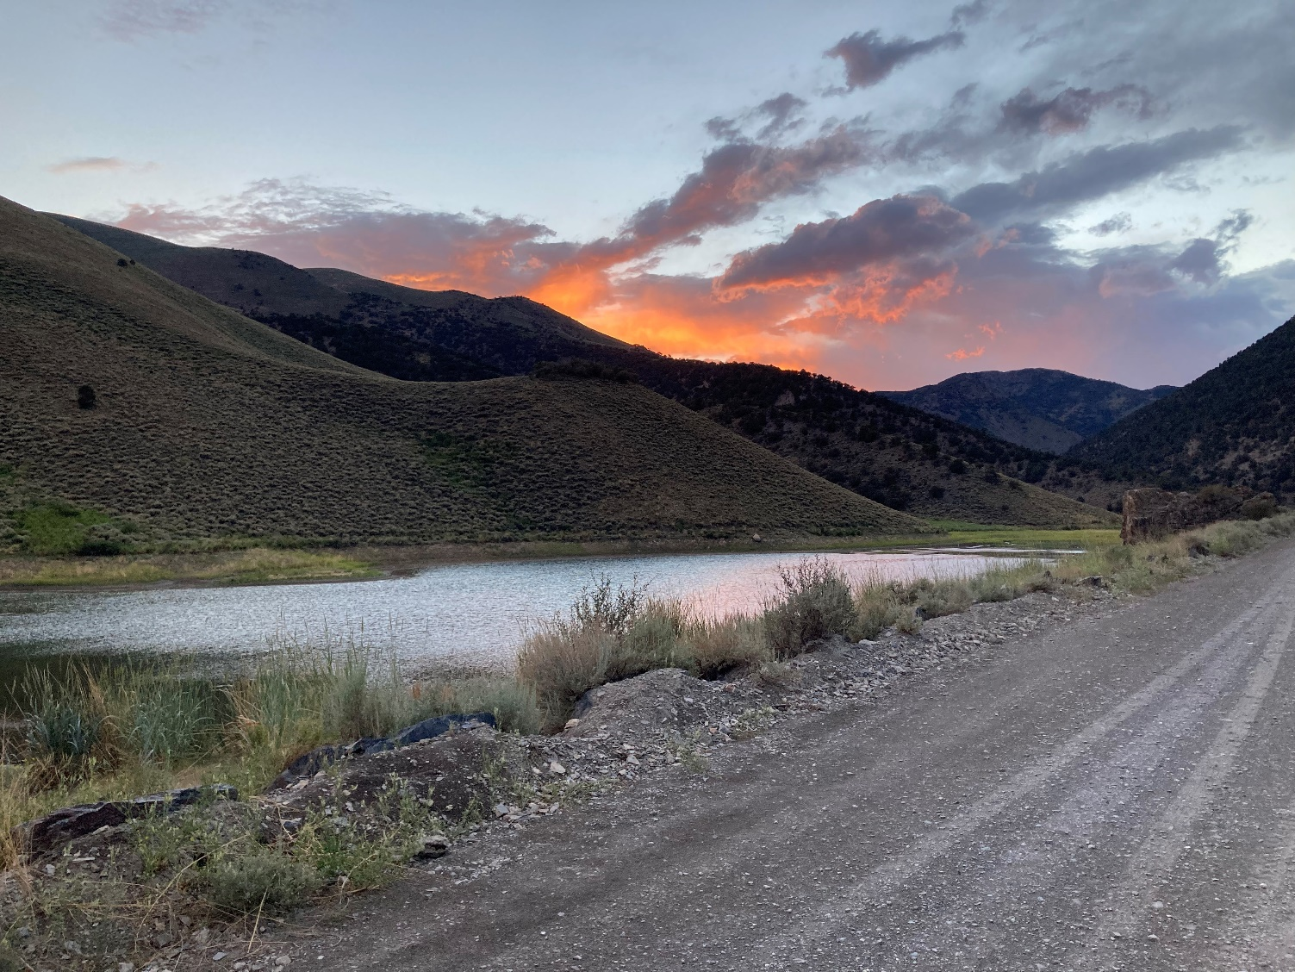
Kingston Canyon Dam Maintenance Project Project # 23140 Kingston, Lander County, Nevada

Slide 12
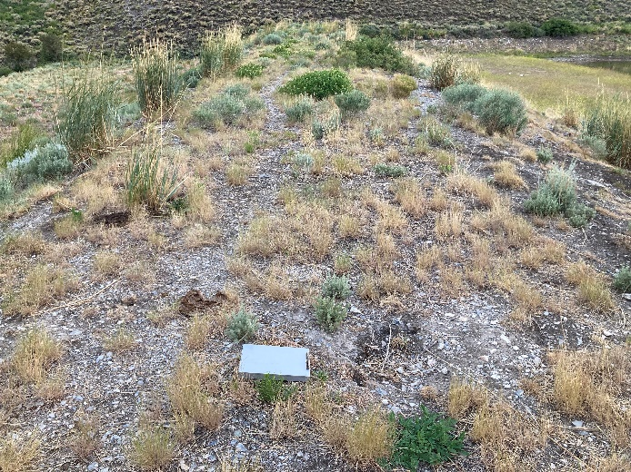
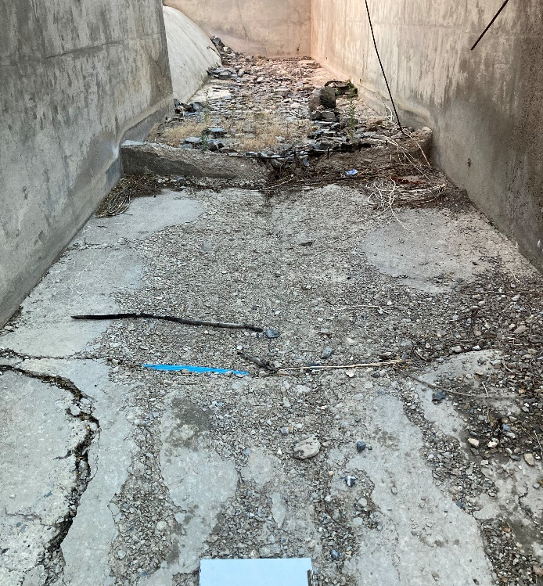
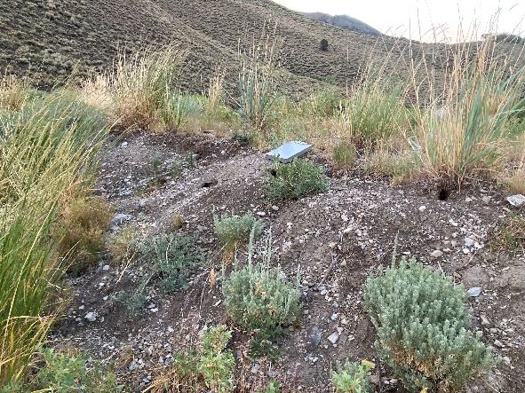
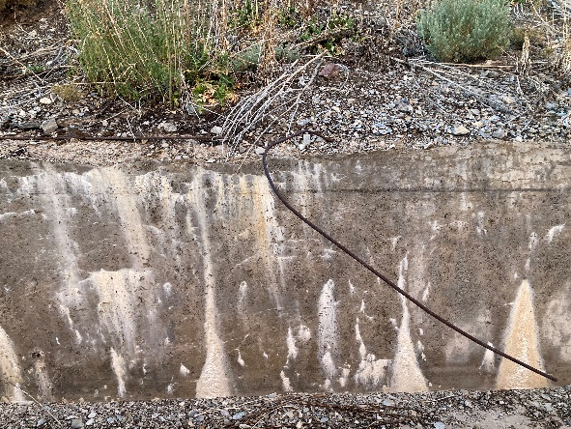
Kingston Canyon Dam Kingston, Lander County, Nevada
Due to downstream development, dam is classified as a High hazard dam. Overall condition of dam is rated as Fair. Division of Water Resources has identified the following items that require corrective action:
Exercise outlet gate of principal spillway.
Repair concrete spalling/cracking in auxiliary spillway to ensure integrity of structure.
Remove obstructions/debris from auxiliary spillway.
Monitor seepage areas for flow rate and turbidity.
Backfill and compact rodent holes and burrows.
Remove vegetation within 25’ of dam structure.
Fill and compact erosion gullies.
Restore dam crest to consistent, uniform grade.
Repair benching and sloping of upstream face of dam.

Slide 13
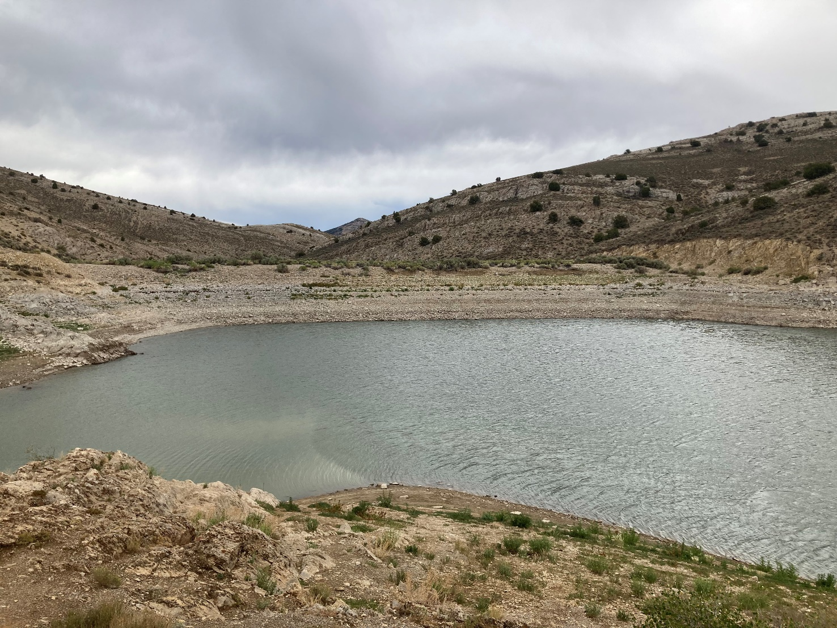
Illipah Dam Maintenance Project Project # 23141 White Pine County, Nevada

Slide 14
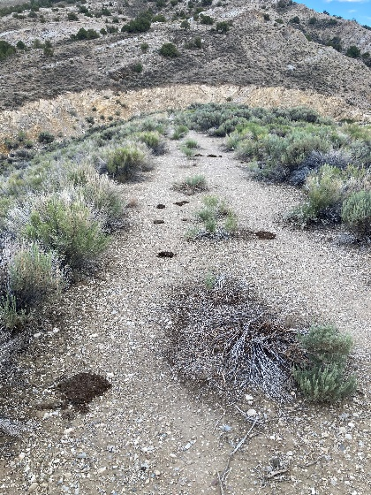
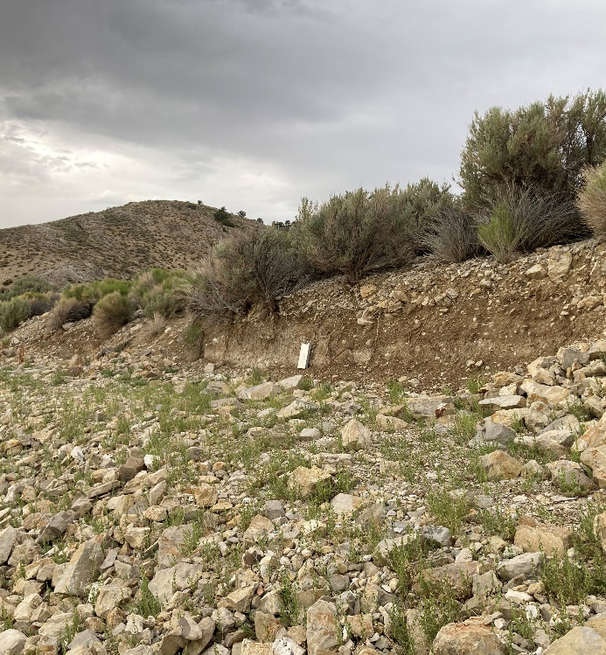
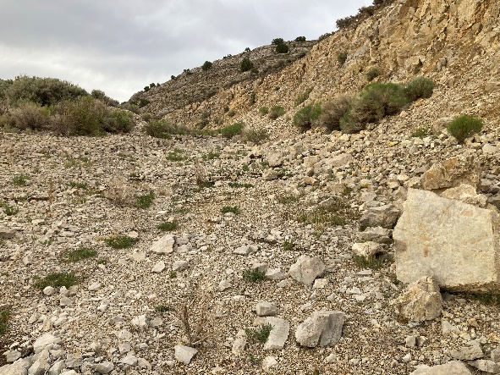
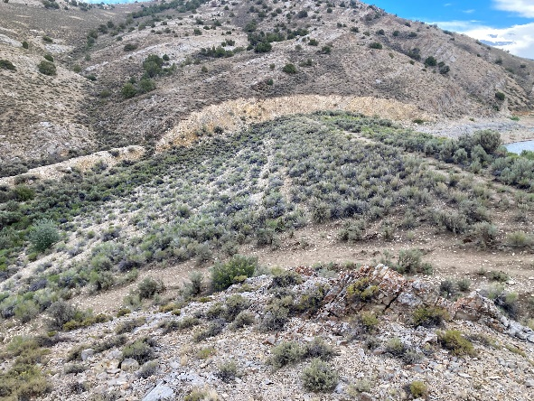
Illipah Dam White Pine County, Nevada
Due to downstream development, dam is classified as a High hazard dam. Overall condition of dam is rated as Fair. Division of Water Resources has identified the following items that require corrective action:
Exercise outlet gate of principal spillway.
Remove obstructions/debris from auxiliary spillway.
Backfill and compact rodent holes and burrows.
Remove vegetation within 25’ of dam structure.
Fence dam to prevent cattle and vehicle traffic from damaging dam.
Restore crest width of dam.
Restore or repair auxiliary spill way channel to remove irregularities.
Restore shape of dam crest to consistent, uniform grade.
Restore upstream face of dam slope to original slope.

Slide 15
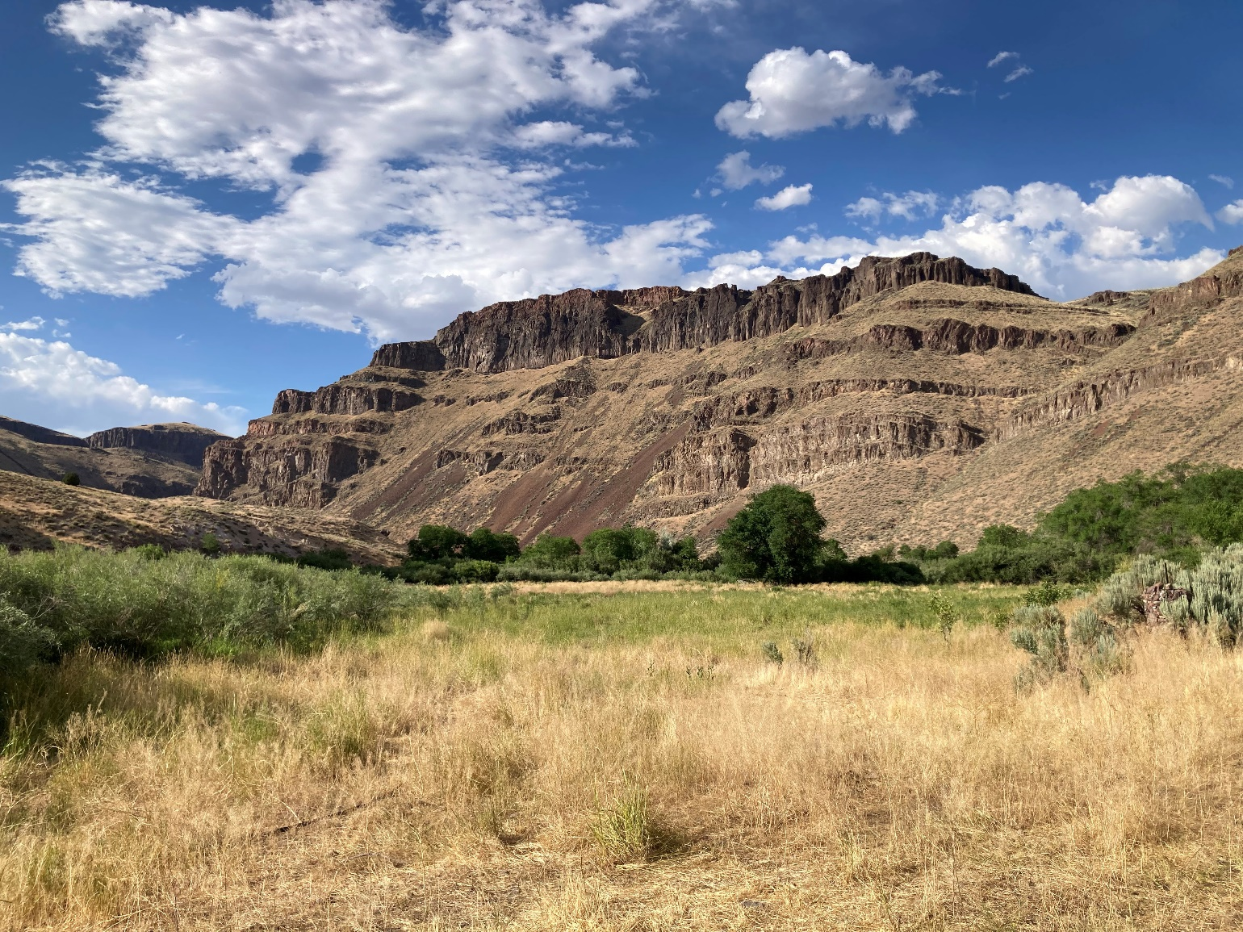
Bruneau River Wildlife Management Area
Structure Demolition
Project #23143
Elko County, Nevada

Slide 16
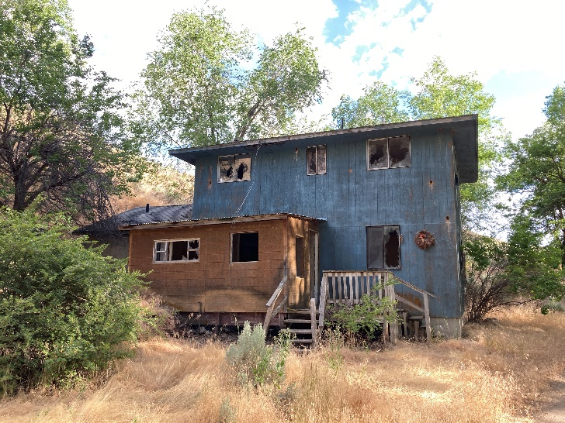
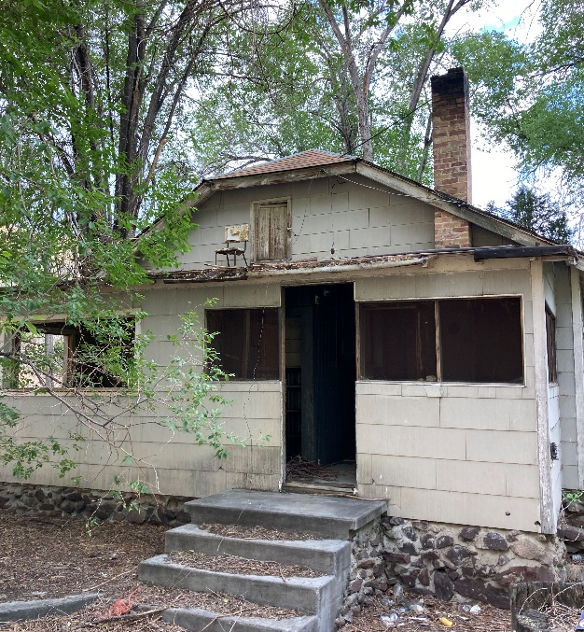
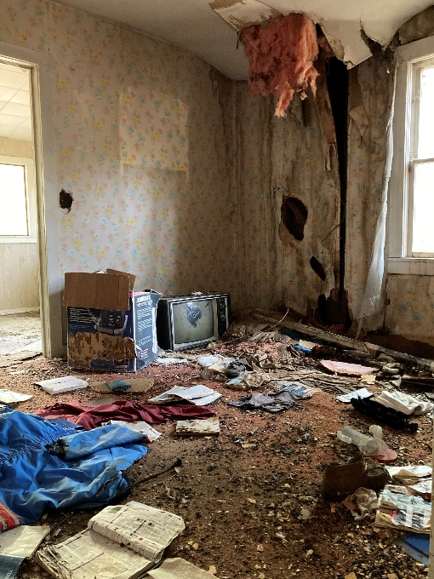
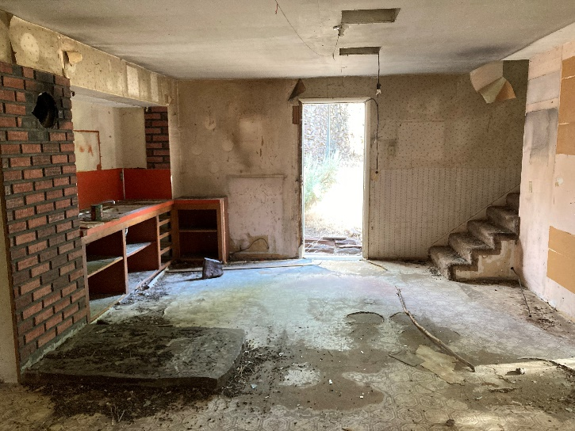
Bruneau River WMA Structure Demolition Elko County, Nevada
Structures pose significant health and safety risks to the general public and State employees, creating unnecessary liability.
Buildings are not structurally sound, are not barricaded, and easily accessible by the public.
Structures were determined to have been constructed with hazardous materials including asbestos containing materials and lead paint.
Buildings have been overrun with pests and pose significant risk of vector borne diseases.

Slide 17
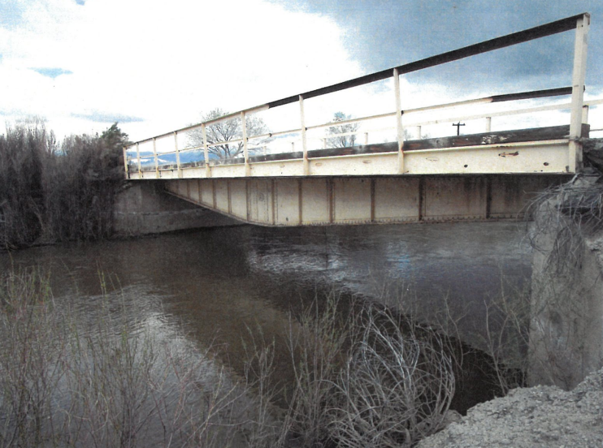
Mason Valley Wildlife Management Area
Lux Lane Bridge Maintenance
Project #23144
Yerington, Lyon County, Nevada

Slide 18
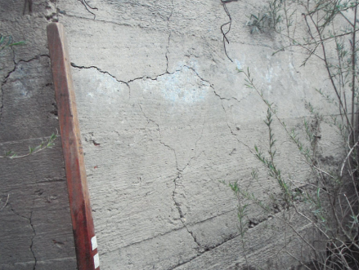
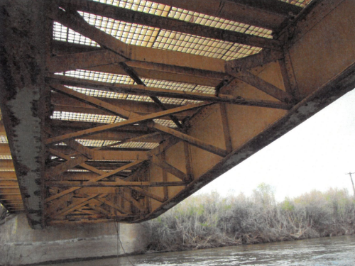
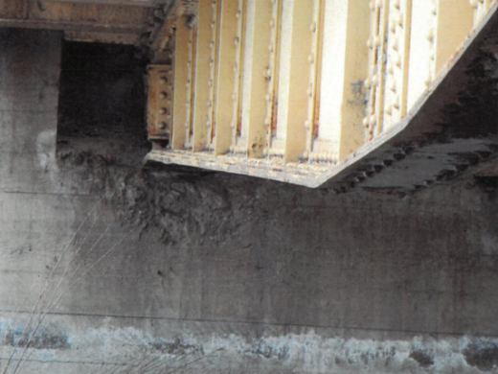
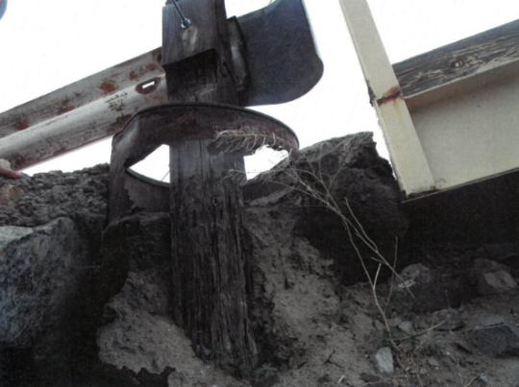
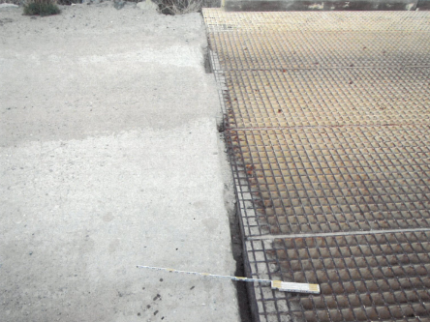
Mason Valley WMA Bridge Maintenance
Yerington, Lyon County, Nevada
Bridge constructed in 1900 and reconstructed in 1987. Has received minimal maintenance since reconstruction. Current rating is 5 on scale of 0 to 9 with 9 being the best. Deficiencies include, but not limited to:
Failed paint system and corrosion of steel deck, girders, diaphragms, floor beams, stringers and bridge railing.
Widespread cracking, exposed rebar, spalling, cold joints, and rock pockets in abutments and retaining walls.
Corrosion and debris covered bearing plates.
Cracked approach slabs exhibiting spalling and large gaps adjacent to the deck.
Decayed timber curbs with failed paint system.
Poor to very poor-quality welding throughout.
Missing rivets throughout.
Damaged or missing approach rails (guardrail) with damaged of missing posts and missing terminals.

Slide 19
Mason Valley Wildlife Management Area
Culvert Replacement
Project #23145
Yerington, Lyon County, Nevada

Slide 20
Mason Valley WMA Culvert Replacement
Yerington, Lyon County, Nevada
Culvert has reached the end of its useful life.
Culvert is compromised and it has been reported that it has completely rusted through the top in places.
There is minimal cover on the culvert creating unusual and excessive loading conditions on the pipe.
Culvert capacity has been decreased by 30% due to accumulation of sediment and debris further deteriorating the pipe.
Guardrail is damaged and missing from east side of culvert.

Slide 21
Ramifications if projects not approved:
1) Gallagher Fish Hatchery Water Intrusion Repairs
Continued building degradation
Structural building failure
Building condemnation
Moisture intrusion
Pest intrusion
Worker health and safety issues
2) Key Pittman WMA Residential Water Intrusion Repairs
Continued building degradation
Moisture intrusion
Worker health and safety issues
Poor living conditions
Continual nuisance
3) Dam Maintenance Projects
Continued degradation
Decreases structural integrity
Possible dam failure
Flooding downstream residents
Possible loss of life
6) Bruneau River WMA Structure Demolition
Possible injury to public and State employees
Potential sickness from vector borne pathogens
Potential health issues from asbestos containing materials and lead paint
7) Mason Valley WMA Lux Lane Bridge Maintenance
Continued bridge degradation
Decreased structural integrity
Possible bridge failure
Possible loss of life or injury
8) Mason Valley WMA Culvert Replacement
Probable flooding
Eminent failure
Loss of main public safety access
Possible injury or loss of life

Slide 22
Department of Wildlife
2023 Capital Improvement Projects
Agency Request
Thank You
for
Your Consideration

